Slide 1
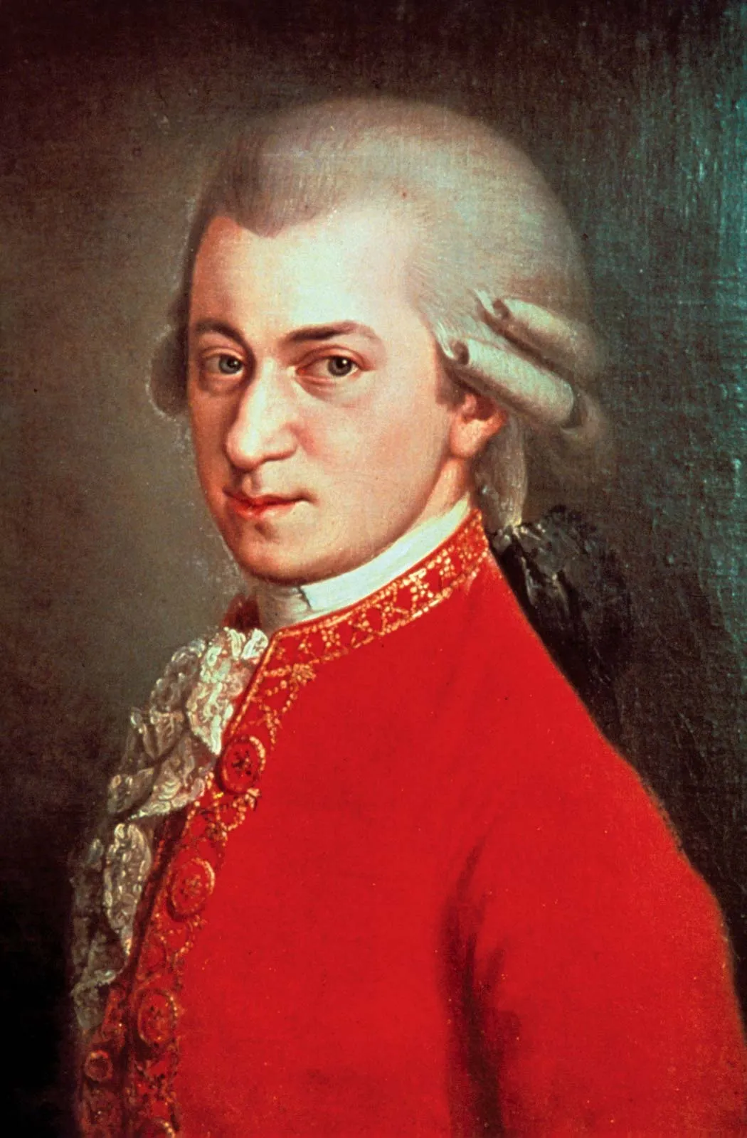
Wolfgang Amadeus mozart
By: Karthik Pothula

Slide 2

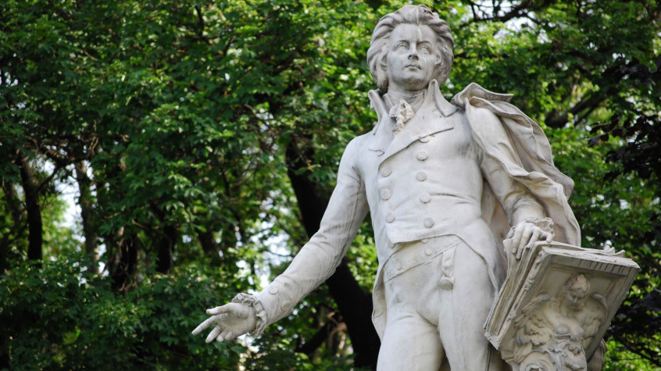

Mozart
Mozart was born in Salzburg, Austria on January 27, 1756
He died on December 5, 1791 in Vienna (The capital of Austria)
Mozart started picking out chords on the harpsichord when he was only three, and started playing short pieces at four, his talent for music was astonishing and it grew as he aged
In early adult life Mozart got employed in March 1773 as a court musician by the ruler of Salzburg, but as the salary was very little, he went elsewhere for employment
On July 3, 1774, Mozart was still out looking for employment, but his mom came down with an illness and passed away
Mozart first started composing music at five years old in the Classical period of music
Mozart’s first composition was “a Minuet and Trio in G majo”
Link of composition: https://www.youtube.com/watch?v=FejHZUyj_Lw

Slide 3







Mozart
Mozart was born in Salzburg, Austria on January 27, 1756
He died on December 5, 1791 in Vienna (The capital of Austria)
Mozart started picking out chords on the harpsichord when he was only three, and started playing short pieces at four, his talent for music was astonishing and it grew as he aged
In early adult life Mozart got employed in March 1773 as a court musician by the ruler of Salzburg, but as the salary was very little, he went elsewhere for employment
On July 3, 1774, Mozart was still out looking for employment, but his mom came down with an illness and passed away
Mozart first started composing music at five years old in the Classical period of music
Mozart’s first composition was “a Minuet and Trio in G majo”
Link of composition:
https://www.youtube.com/watch?v=FejHZUyj_Lw

Slide 4

eine kleine nachtmusik
This is a composition that Mozart has made that is very well-known across the whole world
This was composed on August 10, 1787
The meaning of, “Eine Kleine Nachtmusik” is “A Little Night Music”
It was admired by the lively, joyful, and memorable melodies
String instruments were mainly heard in the composition including, violins, violas, and a cello

Slide 5

Eine Kleine Nachtmusik
https://www.youtube.com/watch?v=r_oK8dKIBYc

Slide 6

Works Cited
https://en.wikipedia.org/wiki/Wolfgang_Amadeus_Mozart
https://www.britannica.com/biography/Wolfgang-Amadeus-Mozart

